Slide 1
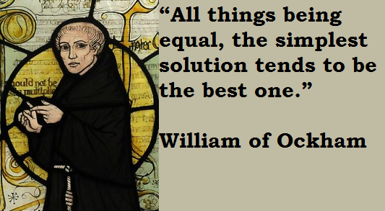
Ockham’s Razor The law of briefness (14th century)

Slide 2
